Slide 1


Slide 2
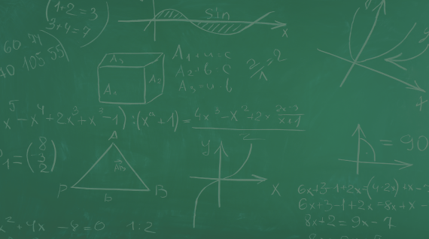

College Night
Event Date: Thursday, October 26 from 6:00pm to 8:00pm at The Center for Performing Arts
Student pre-registration at GoToCollegeFairs.com
or click on the QR code
  Registration steps:
    Select “Students Register”
    Choose “Texas”
    The QR code will get the students to this step.
    (If the students scan the QR code they will continue below.)
    Choose “TACRAO 10/23-10/27”
    Fill out as much info as possible
    Print bar code to bring to event
Registration will be available the night of the event in Lab A
As of today, 130 colleges have registered to attend!

Slide 3
Get your phones out and enter this into your calendar:
College Night: Thursday, October 26 from 6 – 8 at The Center
Colleges give out all kinds of free stuff: backpacks, pencils, pens, flash drives, and much more. Go talk to your number one school and get some information.

Slide 4
IMPORTANT TIMES
Thursday, OCT 26
5:00 – 8:30 Food Trucks out Front
6:00pm Main doors open for students & families (Main Tower)
Registration begins in Lab A (enter through Reception)
There will be maps of college locations once you arrive.
6:15pm Seminars begin in Lecture Halls:
        Preparing for College - Financial Aid Emphasis (West Lecture Hall)
        ACT/SAT Seminar (East Lecture Hall)
7:30pm Seminars repeat in Lecture Halls
8:00pm End of event

